Slide 1
Calculating ground state using QITE and mitigating depolarizing noise
Team: Hosungland
Presenter: Hosung Lee
Team Members: Kihyeon Kim, Dohyun Song

Slide 2

Contents
What is QITE?
QITE vs ITE in Transverse Ising Model
Why QITE ?
Error Mitigation –random compiling
Error Mitigation –zero noise extrapolation
Real time evolution result using Error Mitigation
Ground State Energy of $H_{2} using QITE\&VQE$
Possible Problems with QITE?
Importance of Selecting Parameter
Pulse Calibration

Slide 3

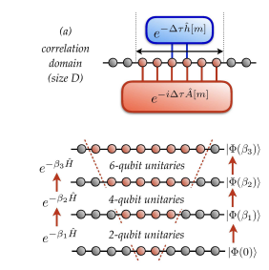







What is QITE?
QITE = Quantum Imaginary Time Evolution
Idea: linearization to compute generators of unitary of step $n+1$, from measured expectation values at step $n$.
Motta et al. Nature Physics(2020): Determining eigenstates and thermal states on a quantum computer using quantum imaginary time evolution

Slide 4
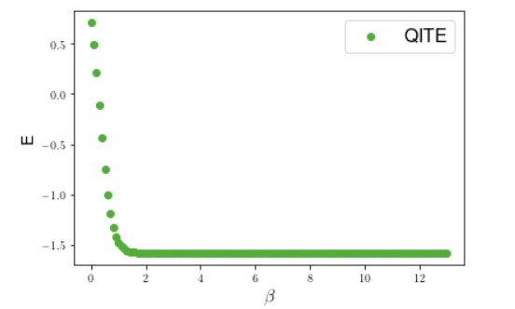
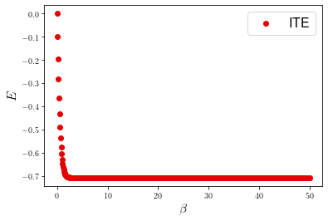
QITE vs ITE in Transverse Ising Model

Slide 5
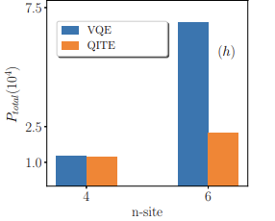
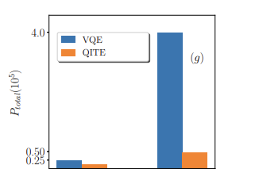
Why QITE ?
When using VQE algorithm, creating ansatz is a complicated problem, and the classical part of the algorithm also requires optimization.
QITE algorithm needs no ansatz.
4
6
Estimate of the number of Pauli string expectation values (Ptotal) needed for QITE and VQE to converge within 1% of the exact energy for a 4-site (left) and 6-site (right) 1D Heisenberg model
Estimate of the number of Pauli string expectation values (Ptotal) needed for QITE and VQE to converge within 1% (2%) of the exact energy for a 4-site (6-site) 1D AFM transverse-field Ising model.
Motta et al. Nature Physics(2020): Determining eigenstates and thermal states on a quantum computer using quantum imaginary time evolution

Slide 6
Error mitigation - random compiling
P | Q | R | S |  | P | Q | R | S |  | P | Q | R | S |  | P | Q | R | S
I | I | I | I |  | Y | I | Y | X |  | X | I | X | X |  | Z | I | Z | I
I | X | I | X |  | Y | X | Y | I |  | X | X | X | I |  | Z | X | Z | X
I | Y | Z | Y |  | Y | Y | X | Z |  | X | Y | Y | Z |  | Z | Y | I | Y
I | Z | Z | Z |  | Y | Z | X | Y |  | X | Z | Y | Y |  | Z | Z | I | Z
P
Q
R
S

Slide 7
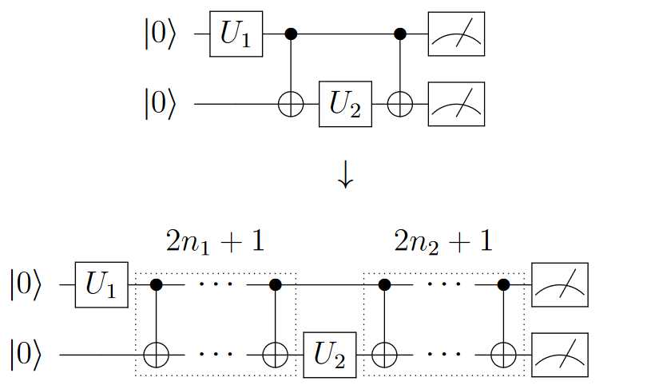
Error mitigation - zero noise extrapolation
Fig. An illustration of identity insertion for a generic controlled unitary operation with two qubits. The $U_{i}$represent unitary matrices and the $n_{i}$ are non-negative integers.

Slide 8
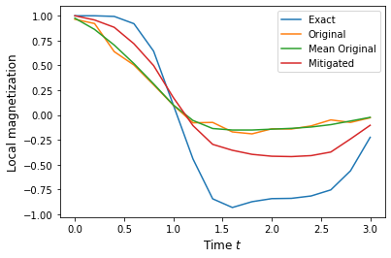
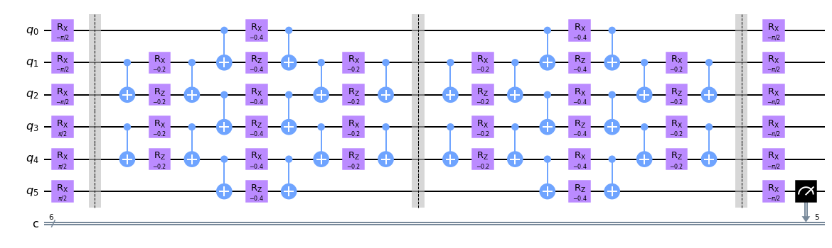
Real time evolution result using Error Mitigation

Slide 9
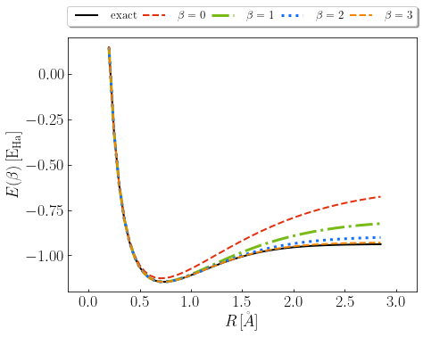
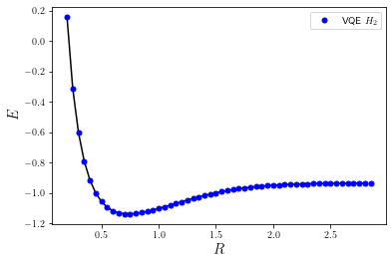
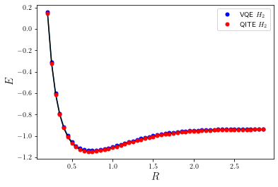
Ground State Energy of $H_{2}$ using QITE&VQE

Slide 10

Possible Problems with QITE
As the beta increases, the circuit repeats more, so noise of hardware is increased.
Also, the accuracy of Trotterization decreases.

Slide 11
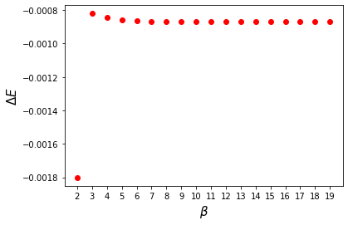
Importance of Selecting Parameter
Due to the hardware noise, proper Δ𝜏 must be set.

Slide 12
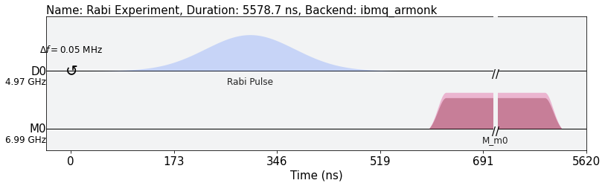
Pulse Calibration
Additionally, to solve the basic problem of noise in hardware, we should apply an algorithm such as pulse-level QITE.

Slide 13
Thank you
Q&A
Contact : hosung0404@snu.ac.kr

